Slide 1
Session 2
Intelligent Agents

Slide 2
Session Outcomes
Student will understand Intelligent Agents & Environments AI.
Student will learn the real world applications.

Slide 3
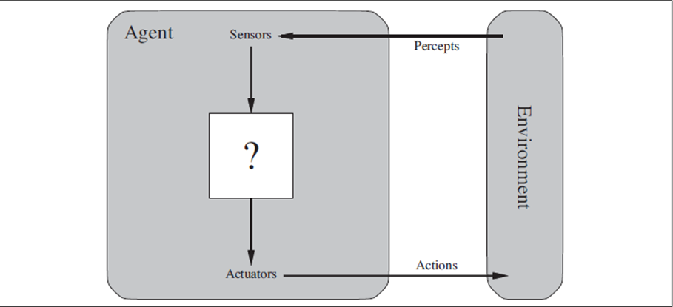
Agents &Environments
An agent is anything that can be viewed as perceiving its environment through sensors and acting upon that environment through actuators.
This simple idea is illustrated in the following figure:

Slide 4
Terminology:
A human agent has eyes, ears, and other organs for sensors and hands, legs, vocal tract, and so on for actuators.
A robotic agent might have cameras and infrared range finders for sensors and switches, motors etc., for actuators.
Percept: We use the term percept to refer to the agent's perceptual inputs at any given instant.
Percept Sequence: An agent's percept sequence is the complete history of everything the agent has ever perceived.
Agent Function: Agent's behavior is described by the agent function that maps any given percept sequence to an action.
Agent Mown: Internally, the agent function for an artificial agent will be implemented by an AGMIT mown.

Slide 5
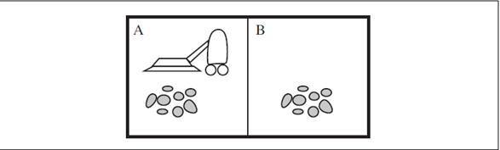
Example for Agent & Environment:
To illustrate the ideas, we use a very simple example—the vacuum-cleaner world shown in the following figure.
This particular world has just two locations: squares A and B.
The vacuum agent perceives which square it is in and whether there is dirt in the square.
It can choose to move left, move right, suck up the dirt, or do nothing.
One very simple agent function is the following: if the current square is dirty, then suck; otherwise, move to the other square.

Slide 6
We can imagine tabulating the agent function that describes any given agent
Given an agent to experiment with, we can, in principle, construct this table by trying out all possible percept sequences and recording which actions the agent does in response)
The table is of course, an external characterization of the agent.
The agent function is an abstract mathematical description; the agent program is a concrete implementation, running within some physical system.
A partial tabulation of this agent function is shown in the following figure.

Slide 7
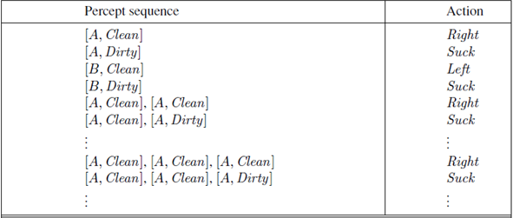
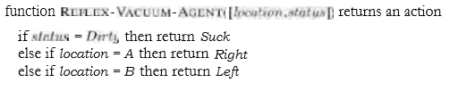
An agent program that implements is as follows:

Slide 8
GOOD BEHAVIOR: THE CONCEPT OF RATIONALITY
Rational Agent:
A rational agent is one that does the right thing. Conceptually speaking, every entry in the table for the agent function is filled out correctly. Obviously, doing the right thing is better than doing the wrong thing, but what does it mean to do the right thing.
Performance Measure:
When an agent is plunked down in an environment, it generates a sequence of actions according to the percepts it receives.
This sequence of actions causes the environment to go through a sequence of states.
If the sequence is desirable, then the agent has performed well. This notion of desirability is captured by a performance measure that evaluates any given sequence of environment states.

Slide 9
Rationality:
What is rational at any given time depends on four things:
The performance measure that defines the criterion of success.
The agent's prior knowledge of the environment.
The actions that the agent can perform.
The agent's percept sequence to date.
This leads to a definition of a rational agent:
For each possible percept sequence, a rational agent should select an action that is expected to maximize its performance measure, given the evidence provided by the percept sequence and whatever built-in knowledge the agent has.

Slide 10
The Nature of Environments
To develop any agent we had to specify the performance measure, the environment, the agent's actuators and sensors. We group all these under the heading of the task environment.
We call this as PEAS (Performance, Environment, Actuators, Sensors) description.
For example, the following table summarizes the PEAS description for the taxi's task environment.

Slide 11
Agent Type | Performance Measure | Environment | Actuators | Sensors
Taxi driver | Safe, fast, legal, comfortable trip, maximize profits | Roads, other traffic, pedestrians, customers | Steering, accelerator, brake, signal, horn, display | Cameras, sonar, speedometer, GPS, odometer, accelerometer, engine sensors, keyboard
PEAS description of the task environment for an automated taxi

Slide 12
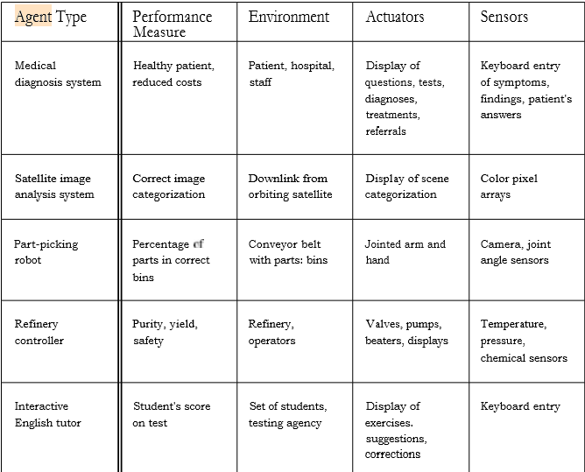
we have sketched the basic PEAS elements for a number of additional agent types in the following table:

Slide 13
Different types of Environment
Fully observable vs. partially Fully observable
Single agent Vs. Multi agent
Deterministic Vs. Stochastic
Episodic Vs. Sequential
Static vs. Dynamic
Discrete vs. Continuous
Known vs. Unknown

Slide 14
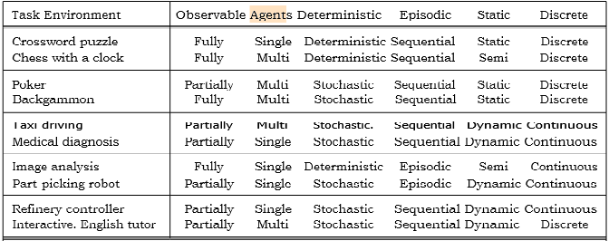
The following table lists the properties of a number of familiar environments:
End of session

